Slide 1
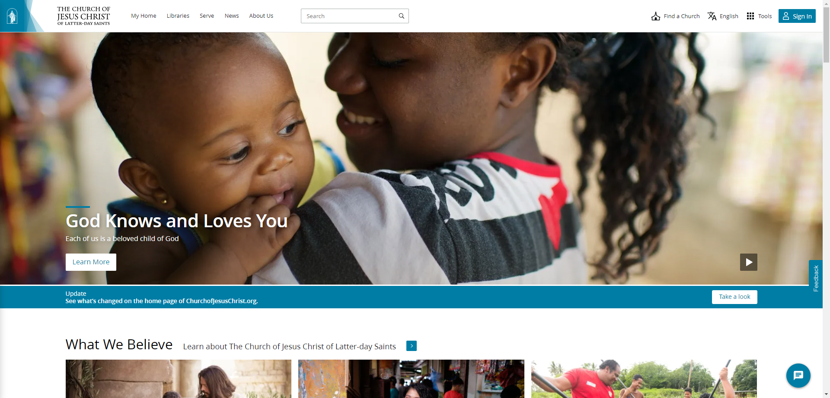

Slide 2
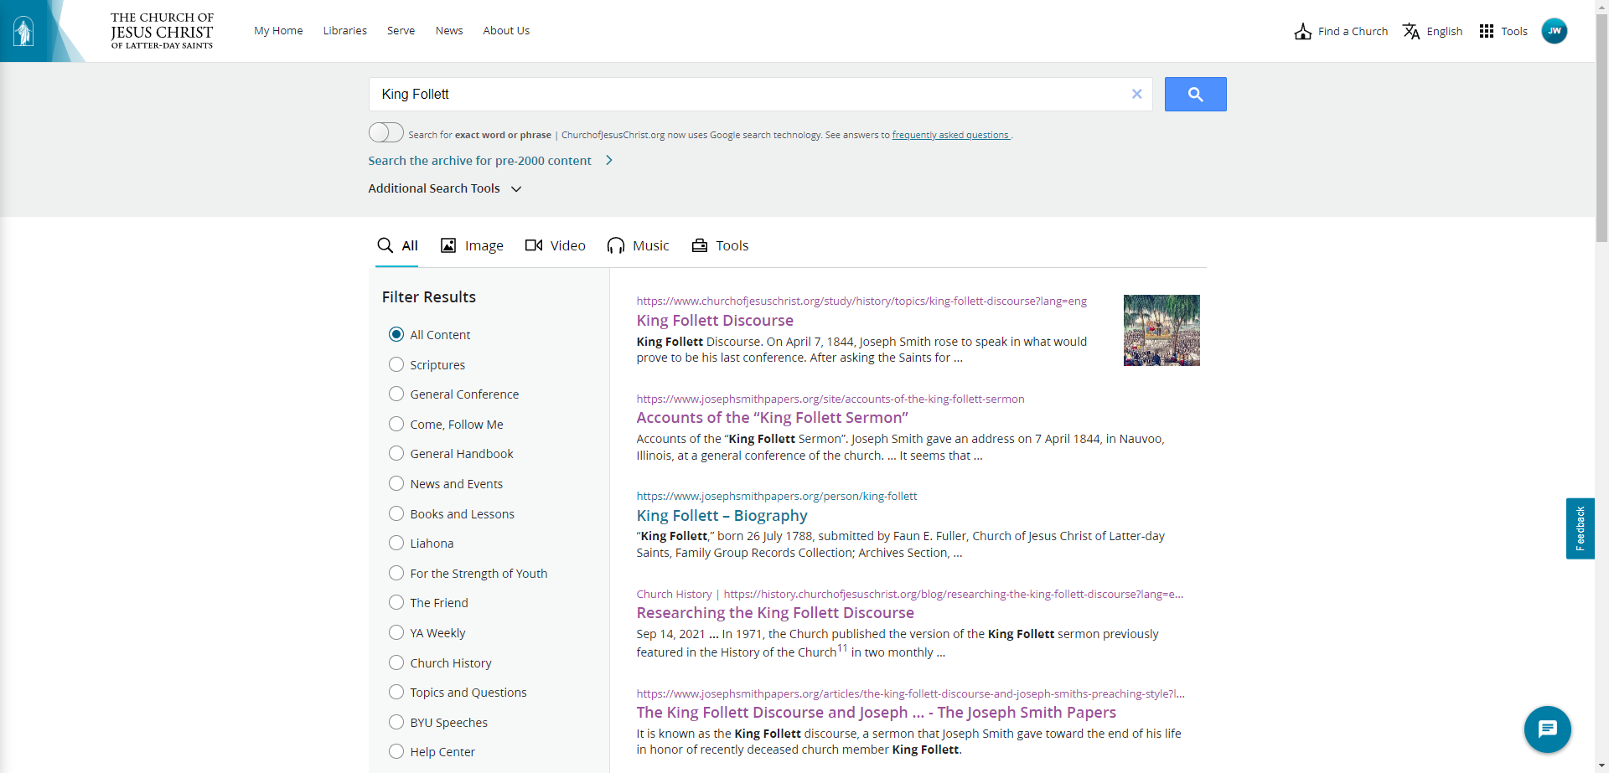

Slide 3
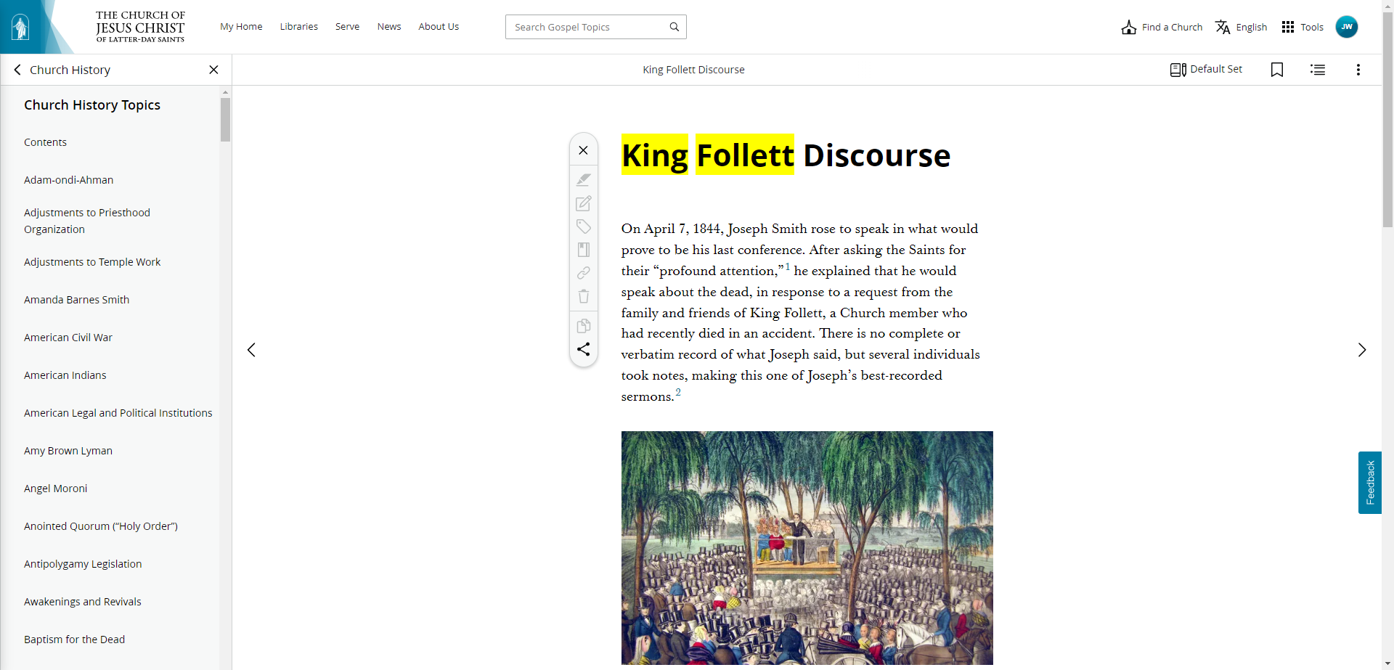

Slide 8
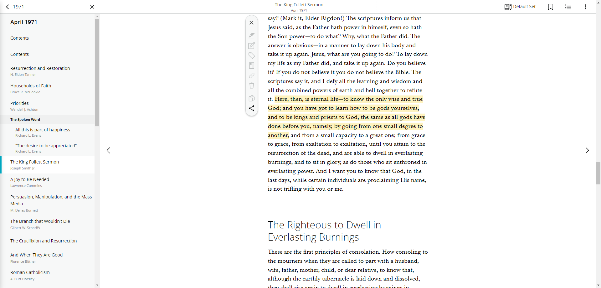

Slide 9
Mormons
Isaiah 43:10-11 "You are my witnesses," declares the LORD, "and my servant whom I have chosen, that you may know and believe me and understand that I am he. Before me no god was formed, nor shall there be any after me. I, I am the LORD, and besides me there is no savior.

Slide 10
Mormons
Isaiah 44:4,6 They shall spring up among the grass like willows by flowing streams… Thus says the LORD, the King of Israel and his Redeemer, the LORD of hosts: "I am the first and I am the last; besides me there is no god.

Slide 11
Mormons
Isaiah 45:5-6 I am the LORD, and there is no other, besides me there is no God; I equip you, though you do not know me, 6 that people may know, from the rising of the sun and from the west, that there is none besides me; I am the LORD, and there is no other.

Slide 12
Mormons
Isaiah 45:22 "Turn to me and be saved, all the ends of the earth! For I am God, and there is no other.

Slide 13
Mormons
Psalm 96:5 For all the gods of the peoples are worthless idols, but the LORD made the heavens.

Slide 14
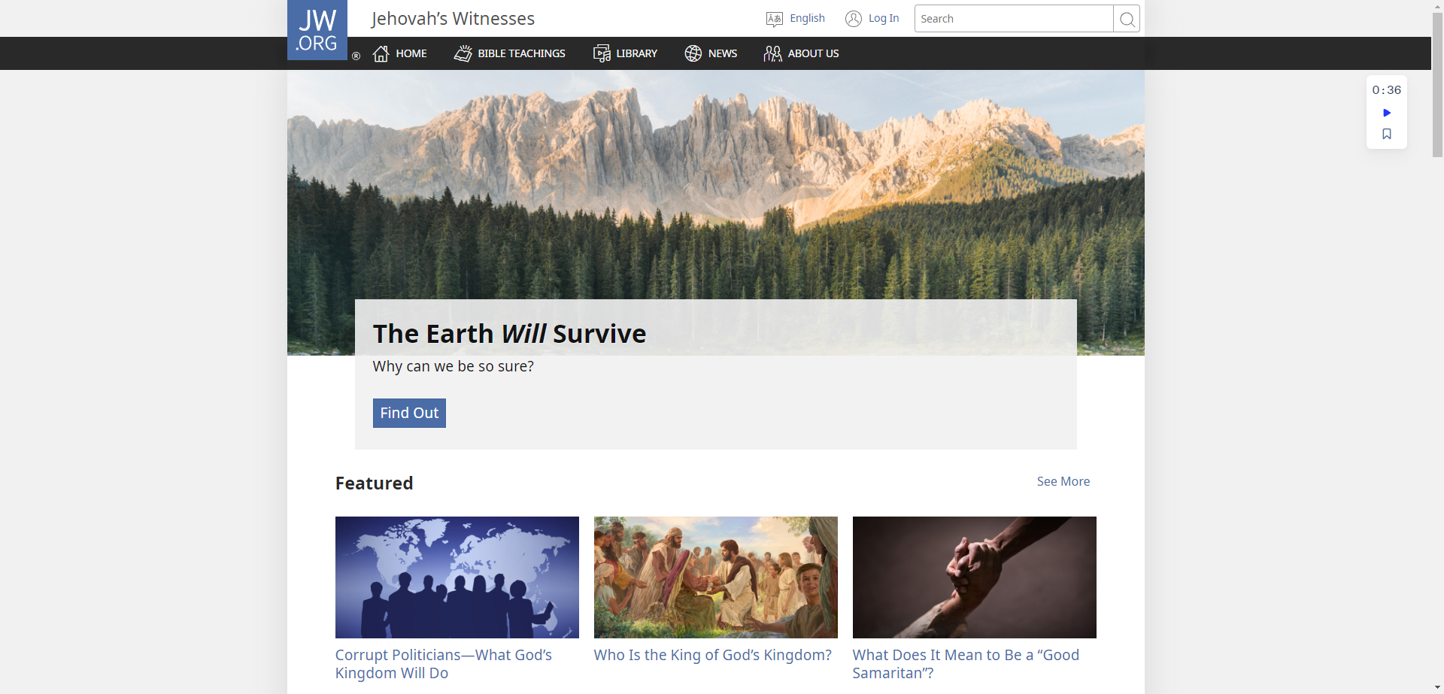

Slide 15
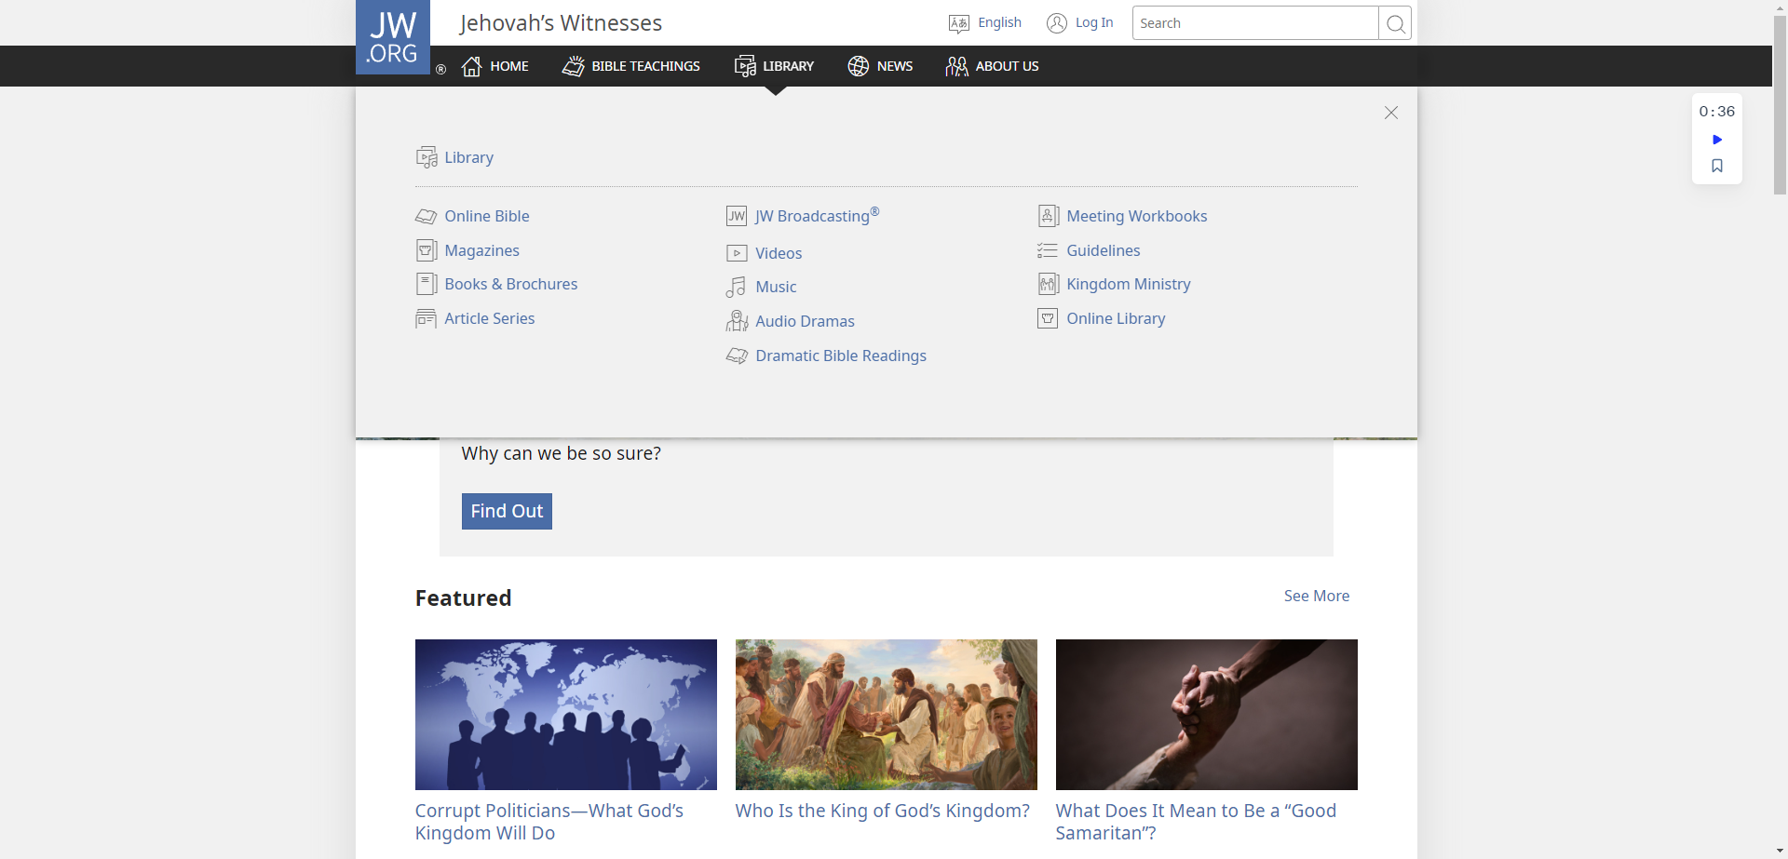

Slide 18
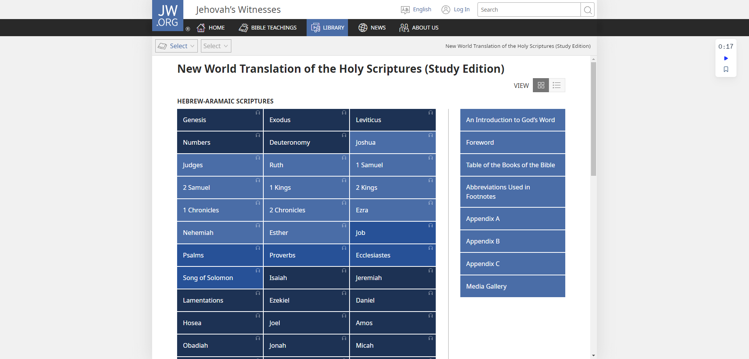

Slide 19
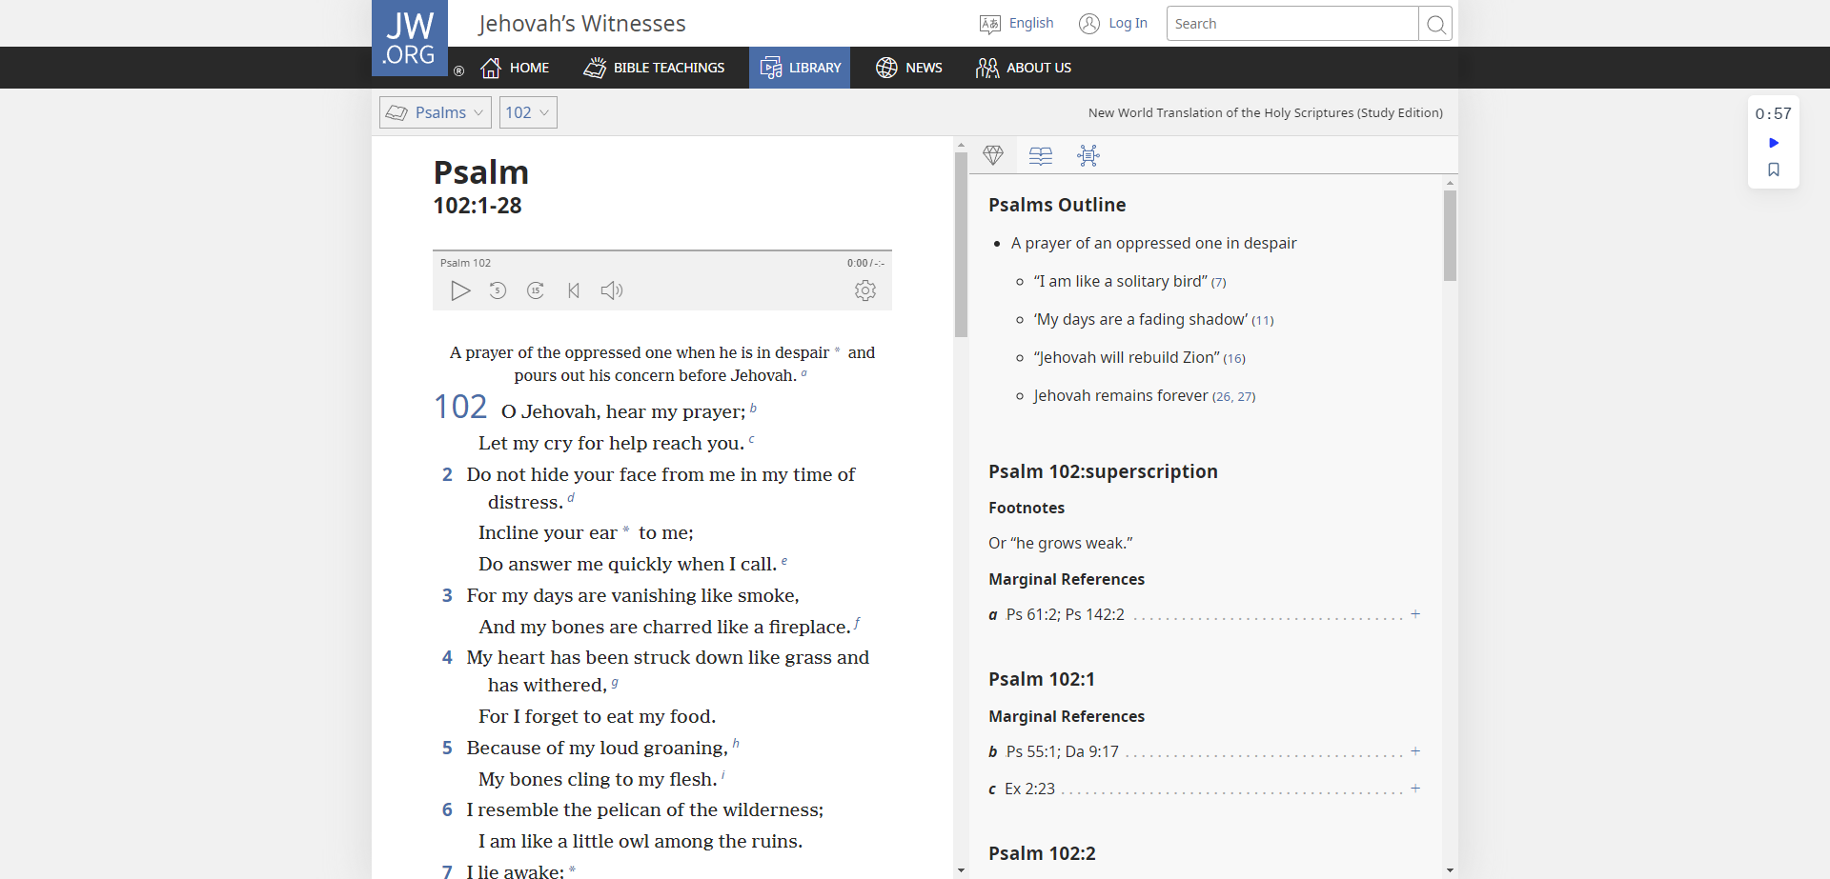

Slide 20
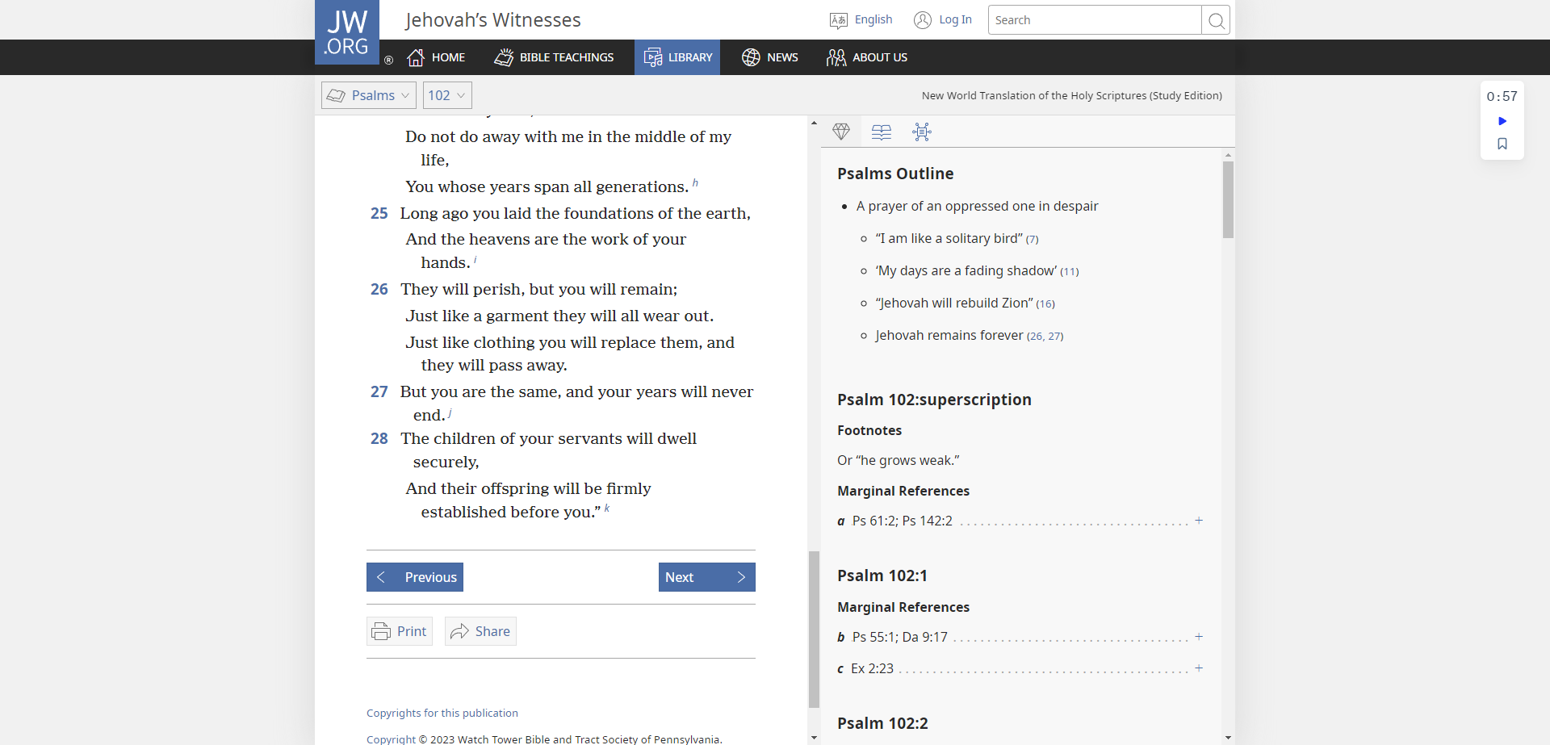

Slide 21
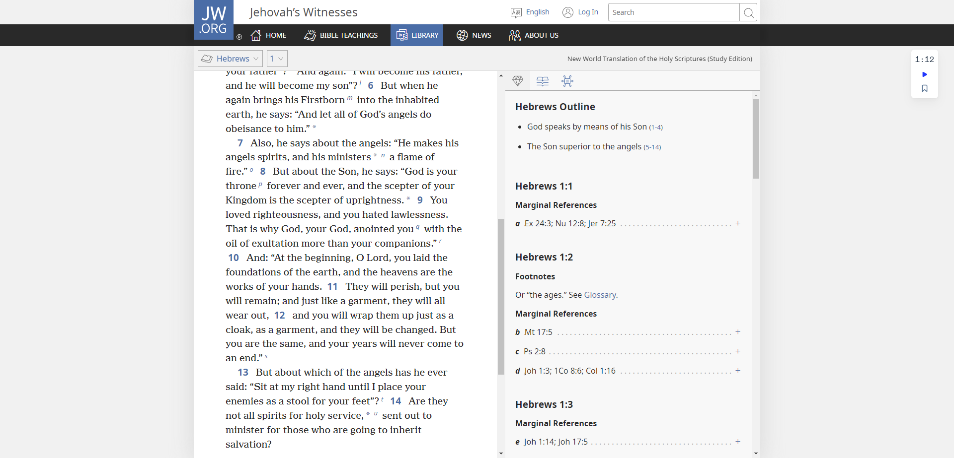

Slide 23
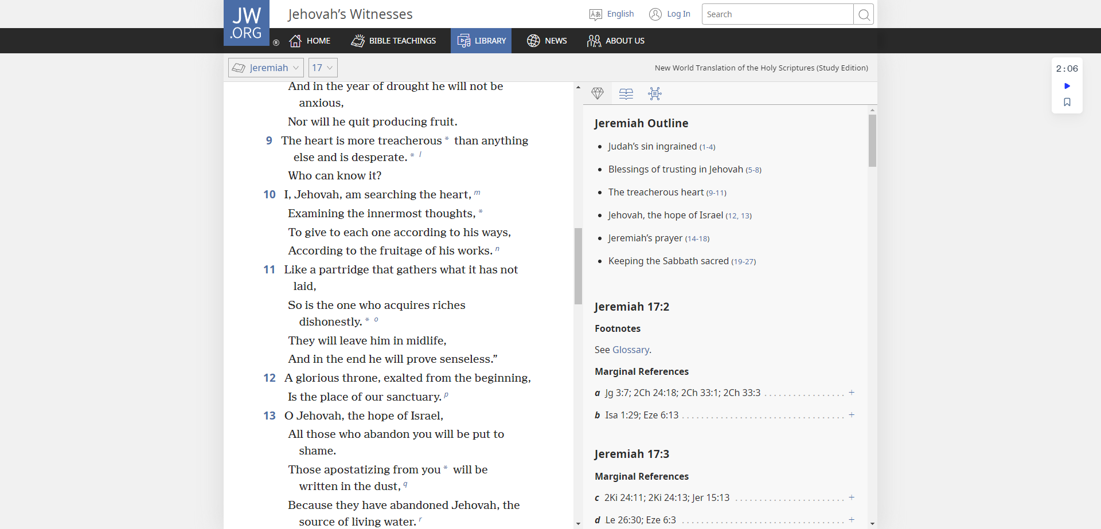

Slide 24
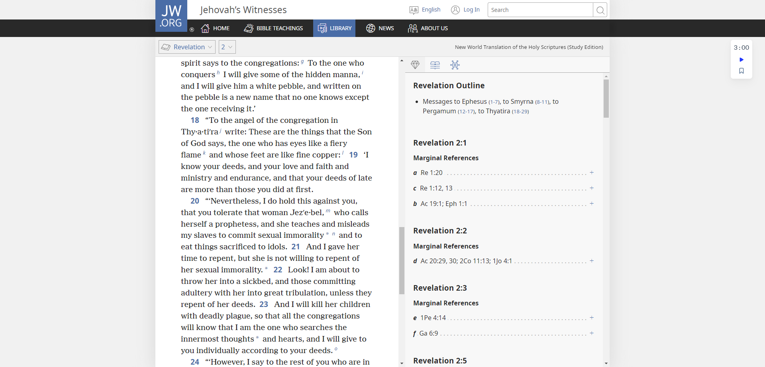

Slide 26
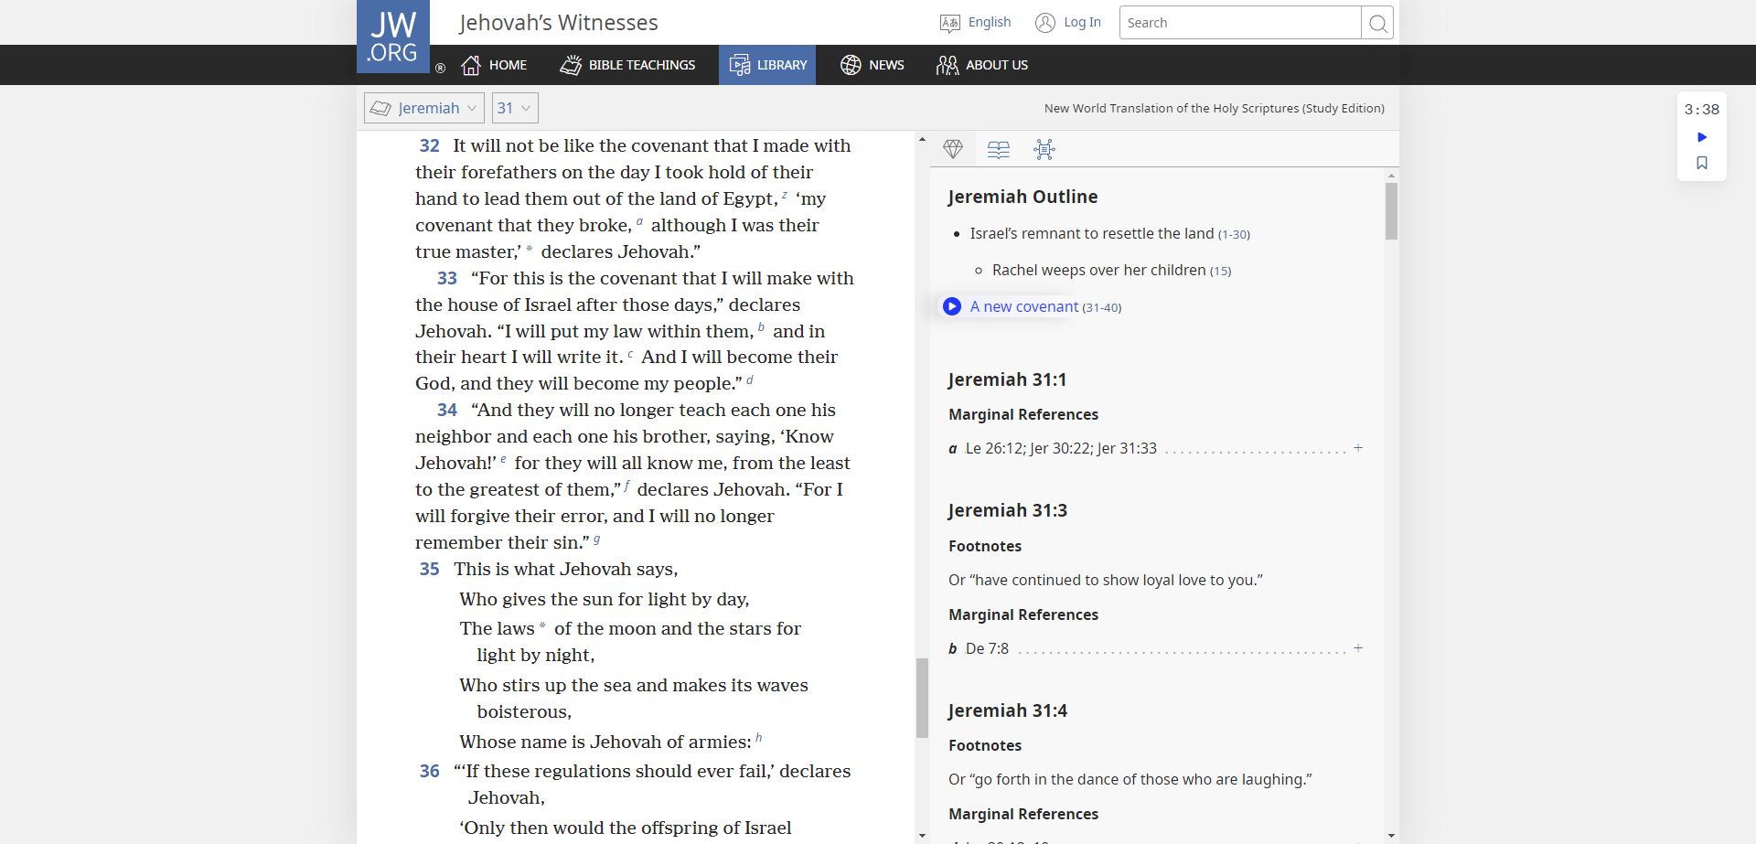

Slide 27
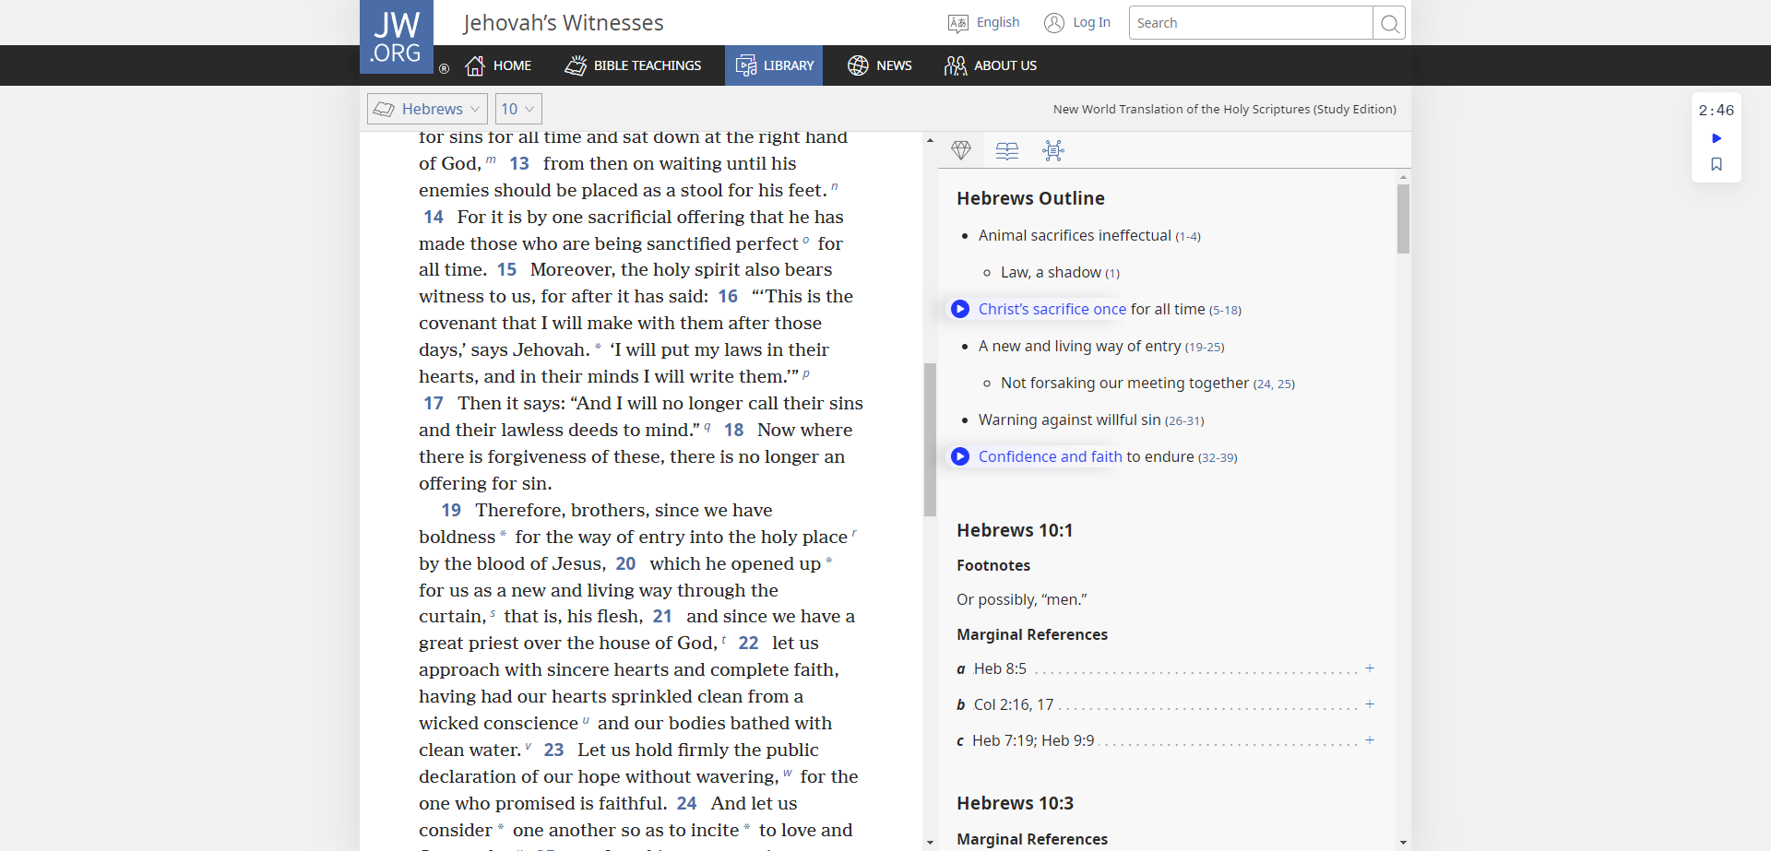

Slide 28
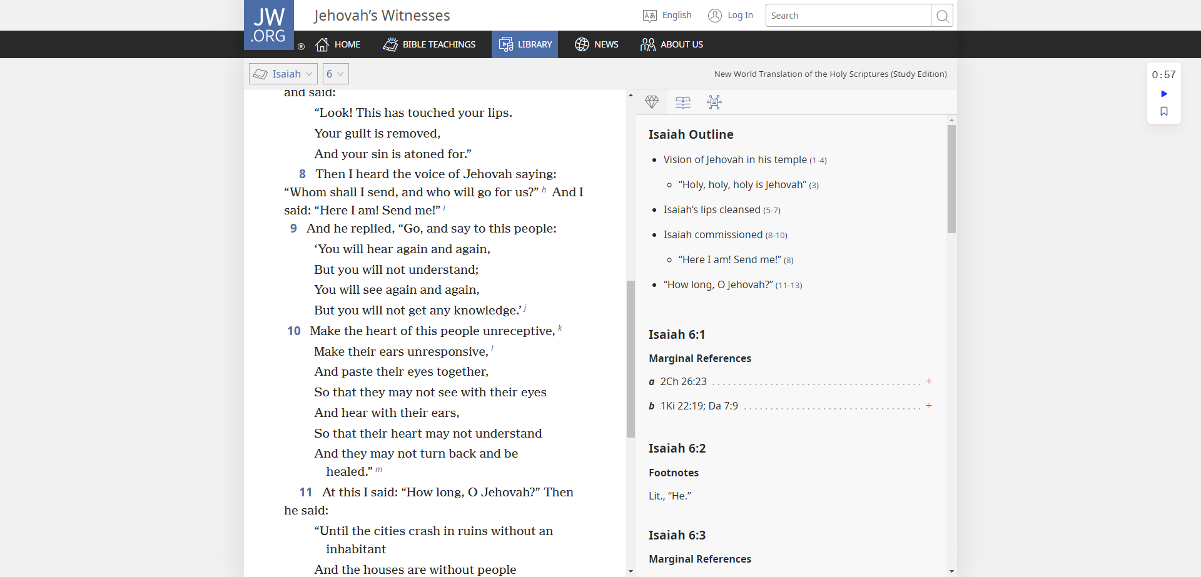

Slide 29
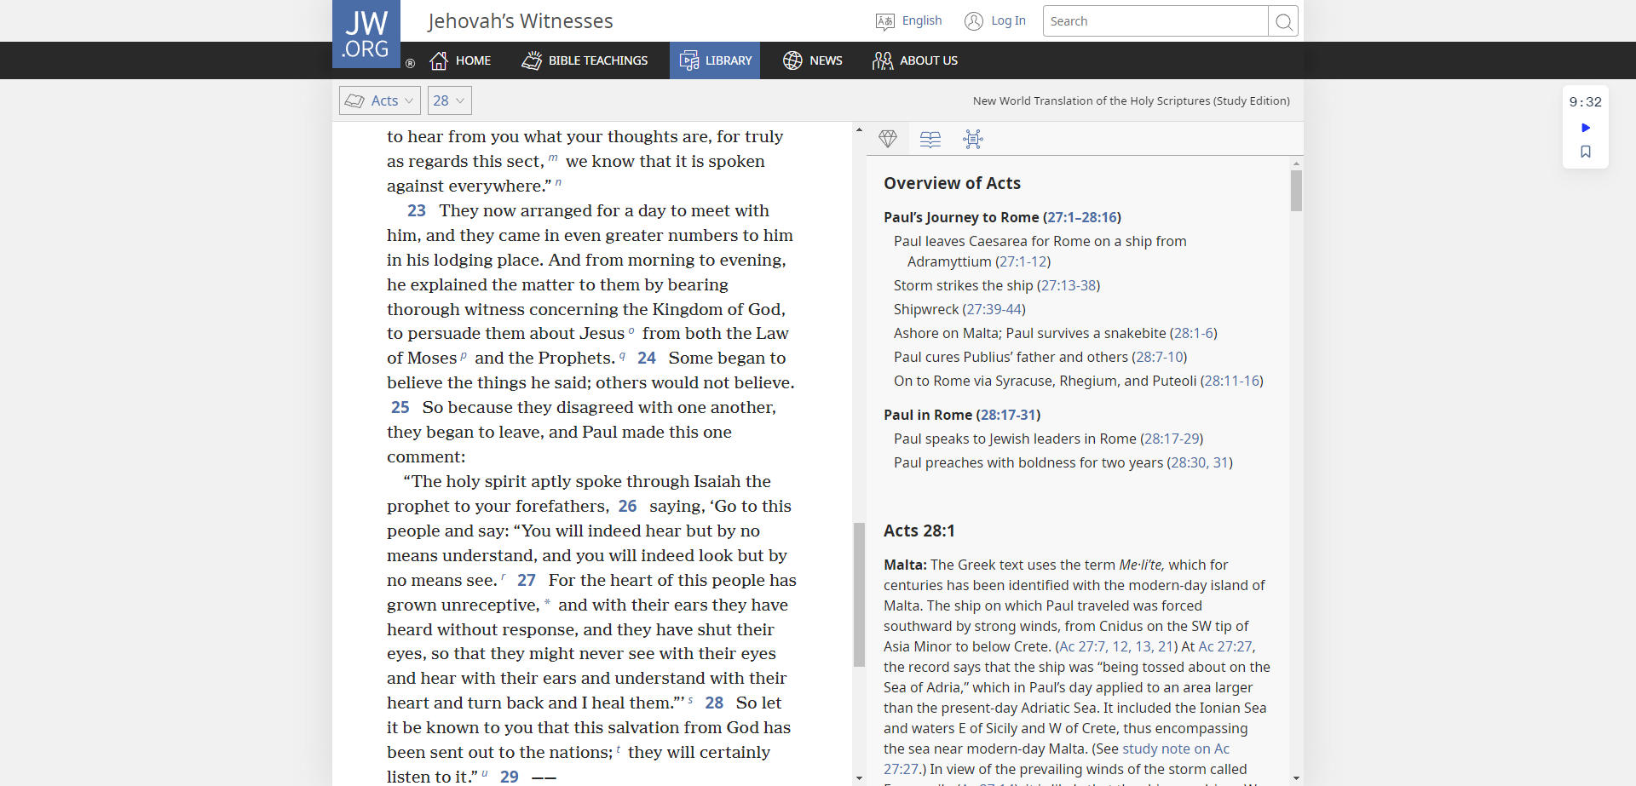

Slide 31
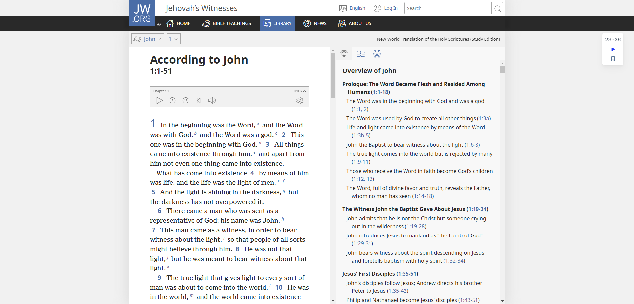

Slide 33
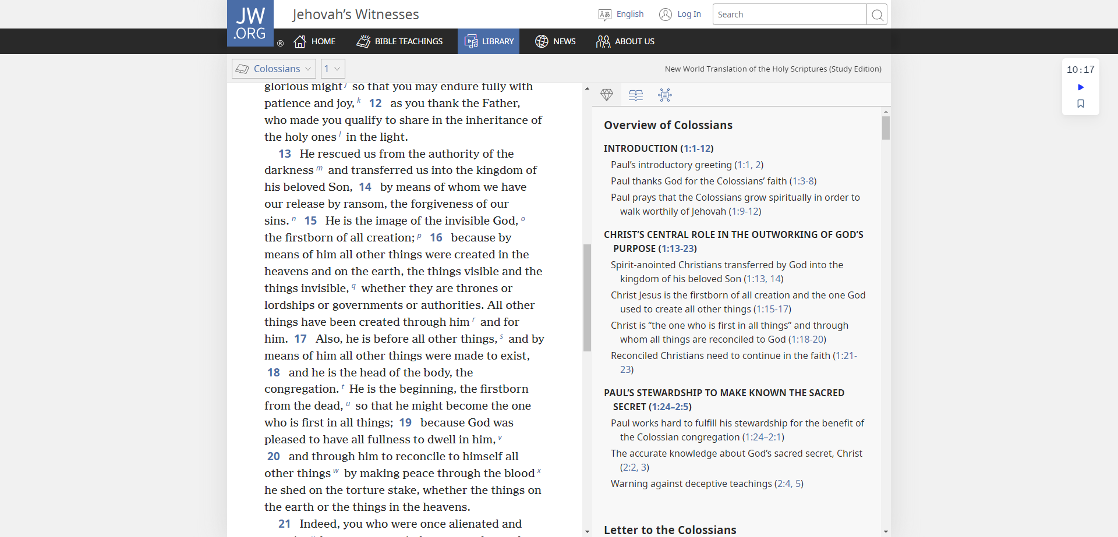

Slide 34
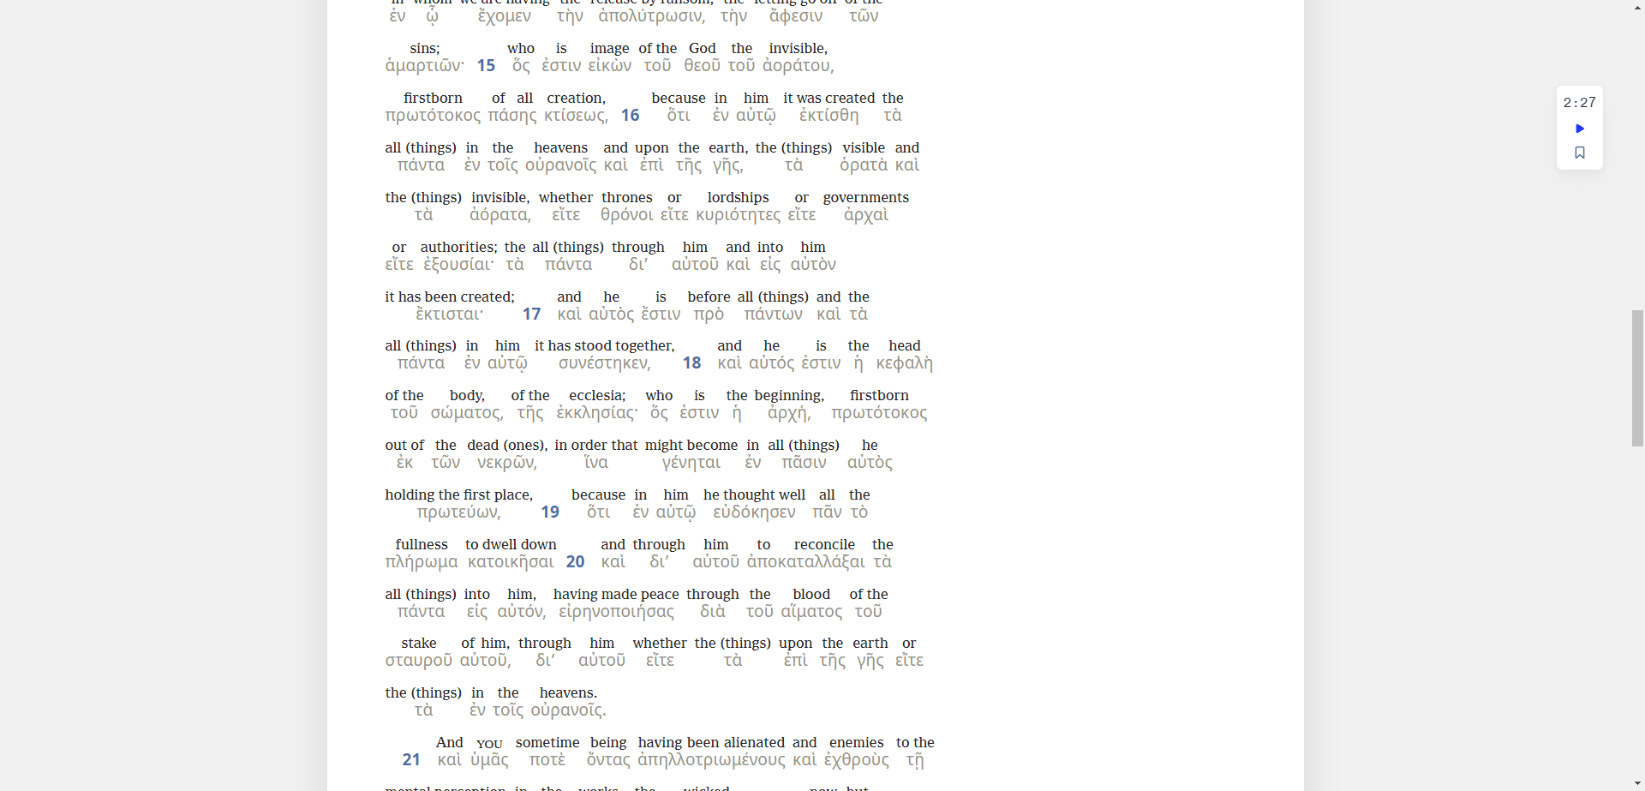

Slide 36
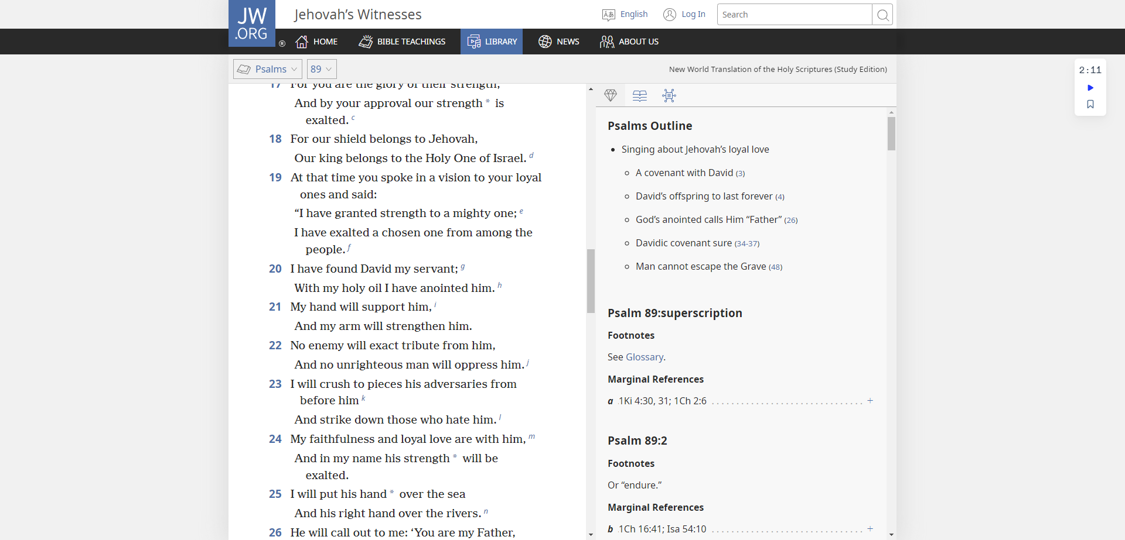

Slide 37
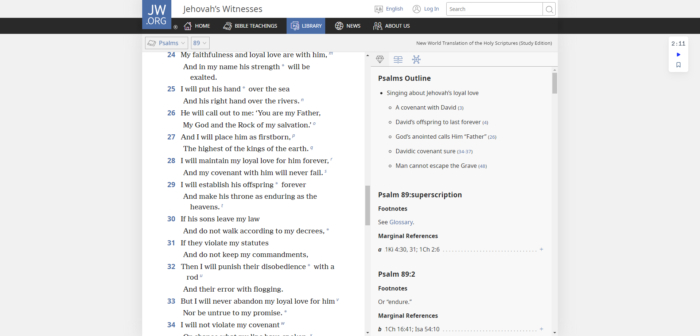

Slide 38
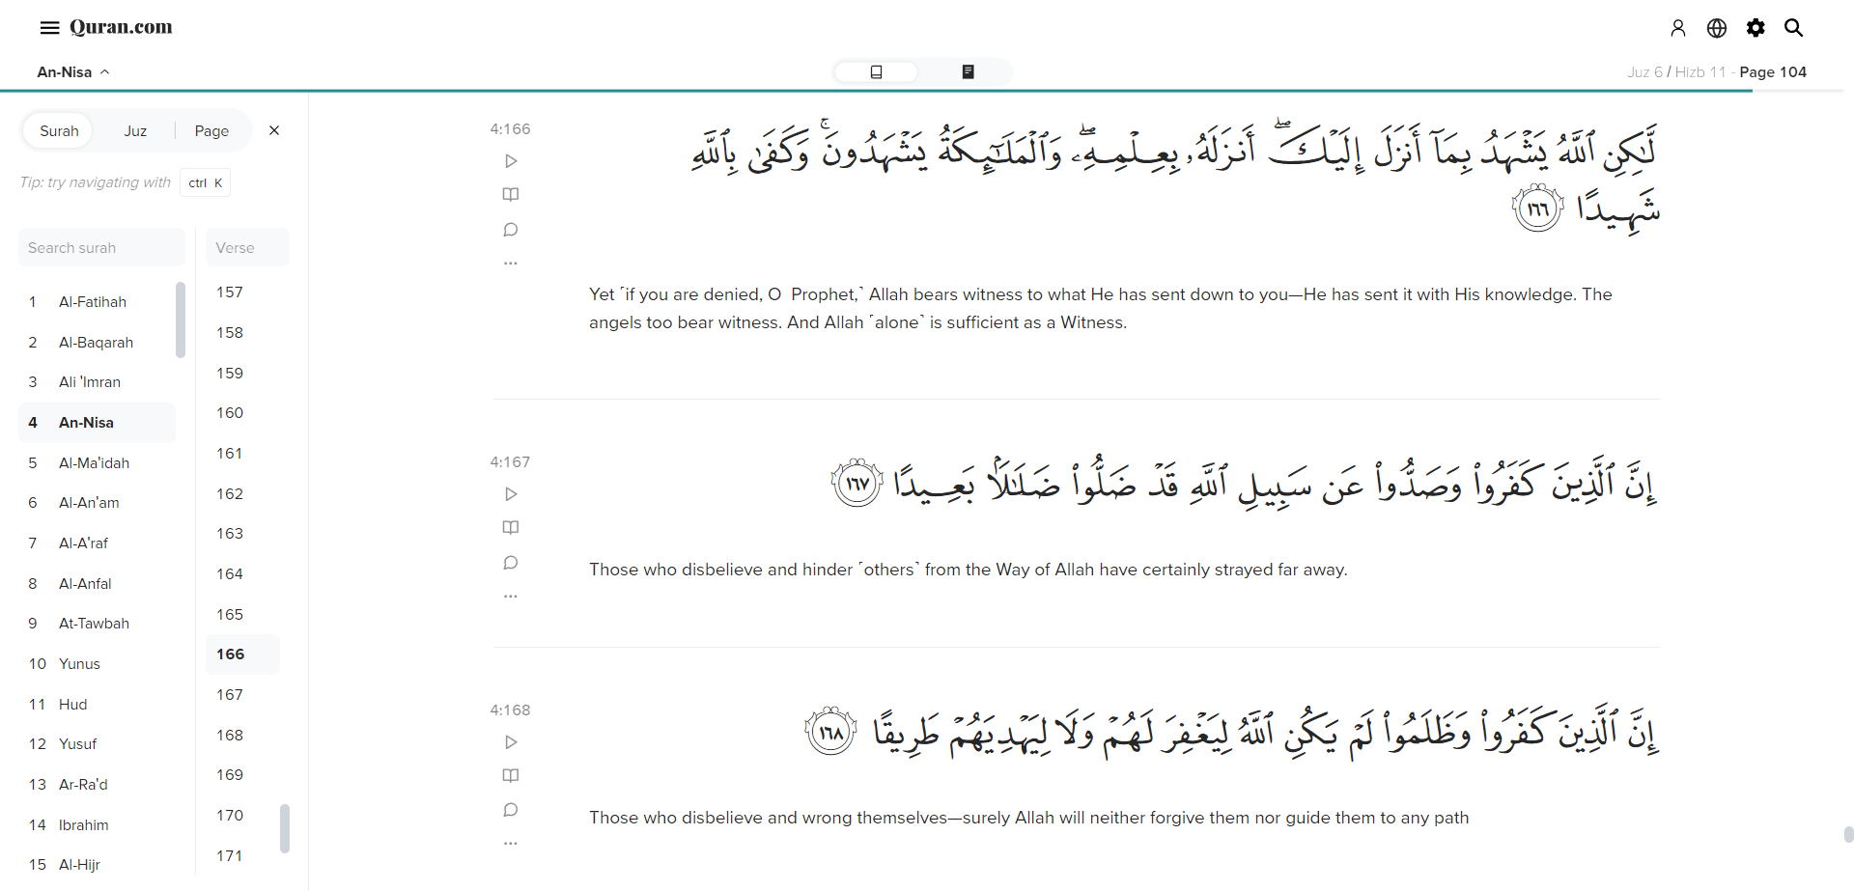

Slide 40
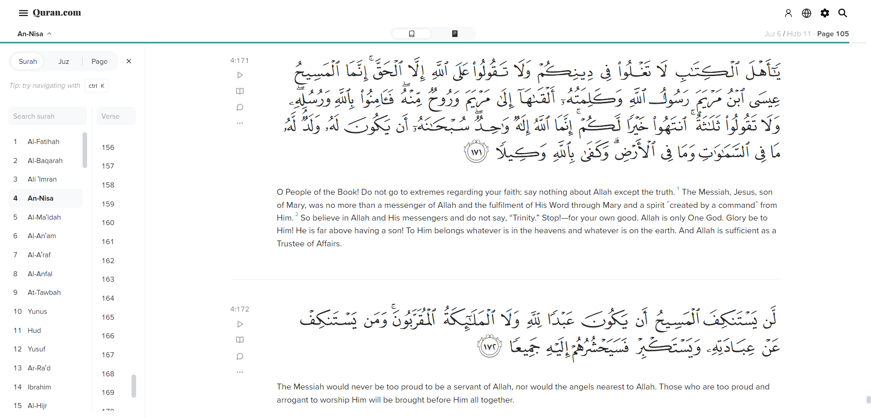

Slide 42
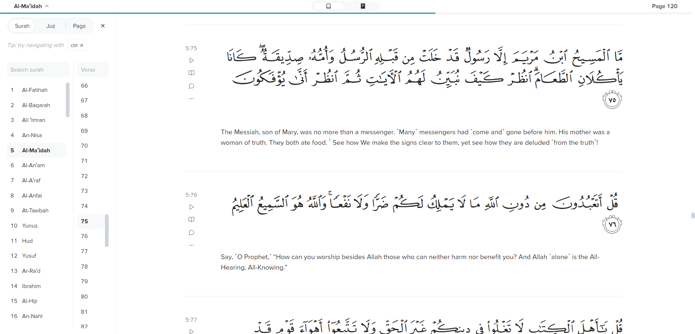

Slide 43
